Slide 1
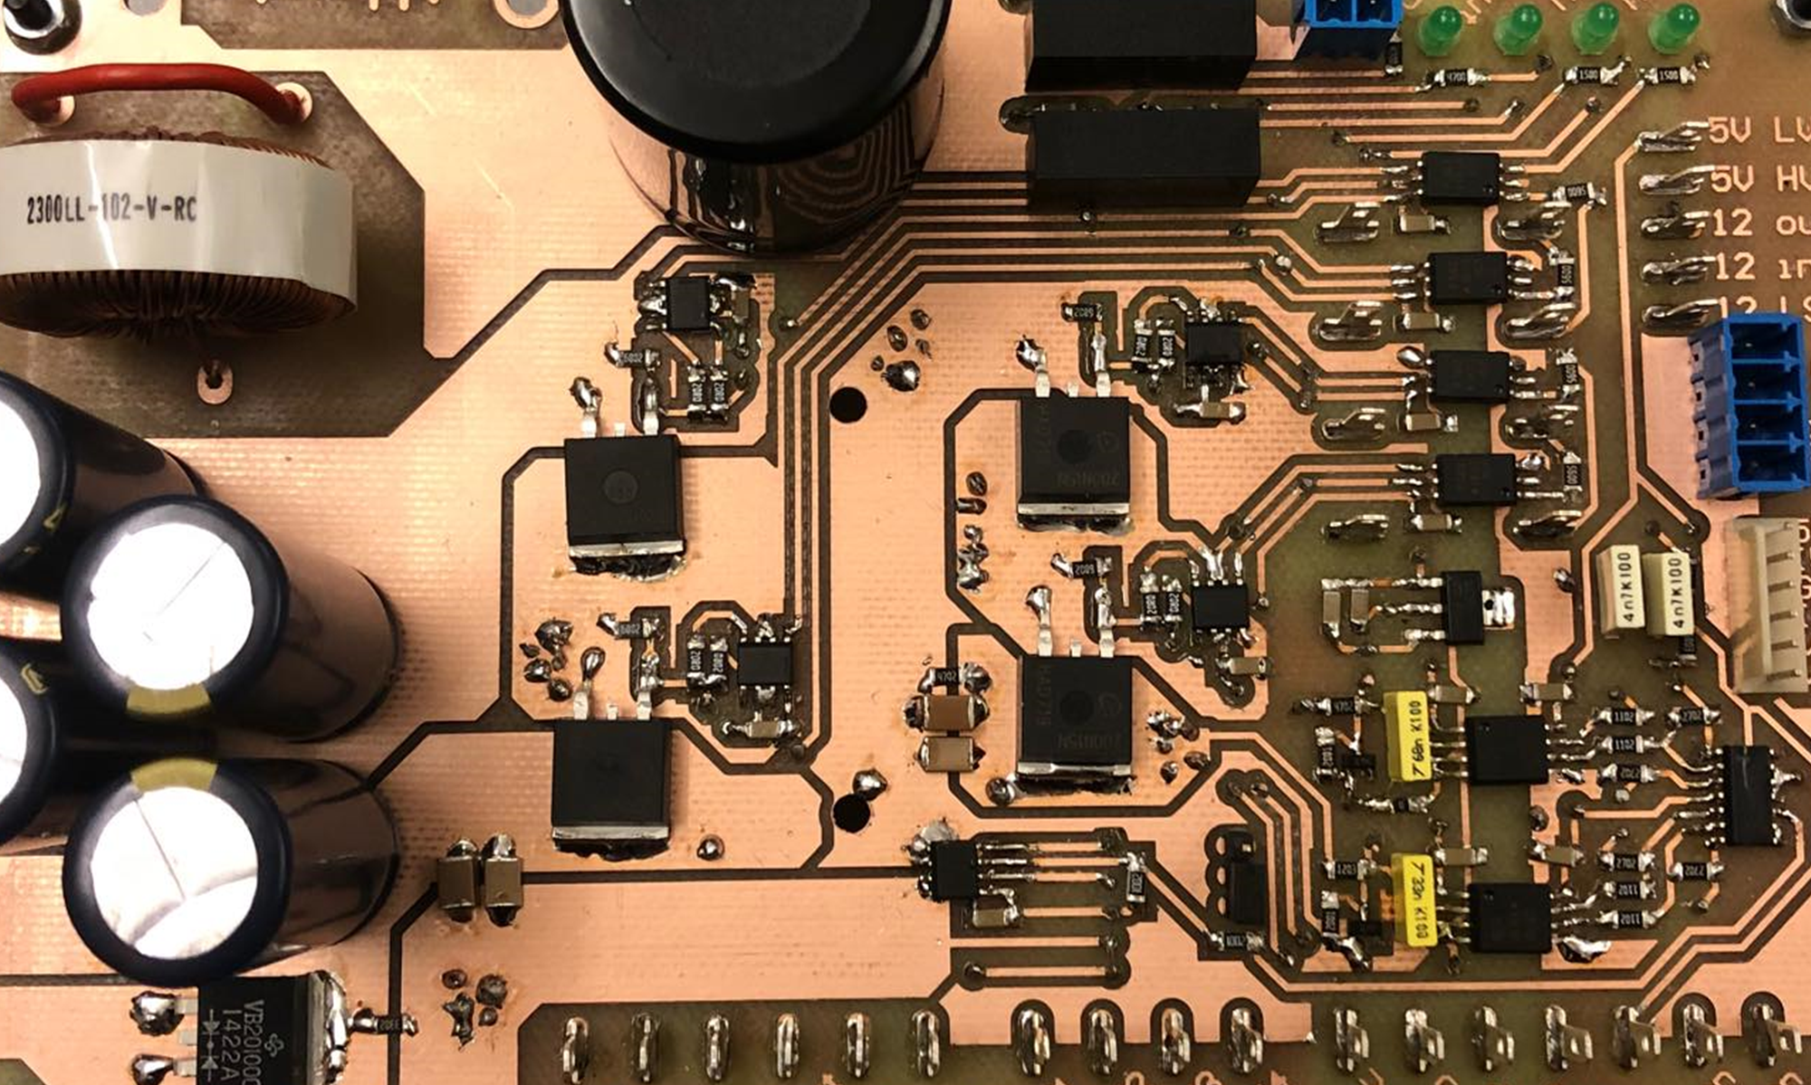
Test results
Notes:
Motivation
Existing problems
What is a MIC
Why a MIC
Problem statement

Slide 2
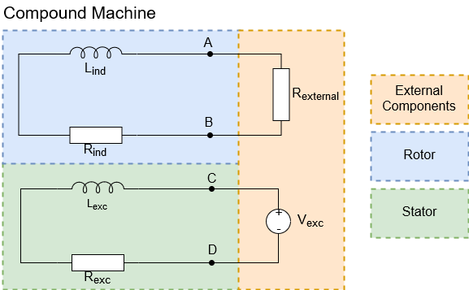
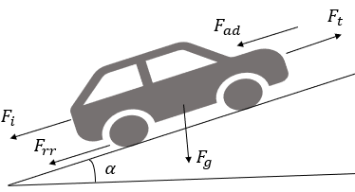
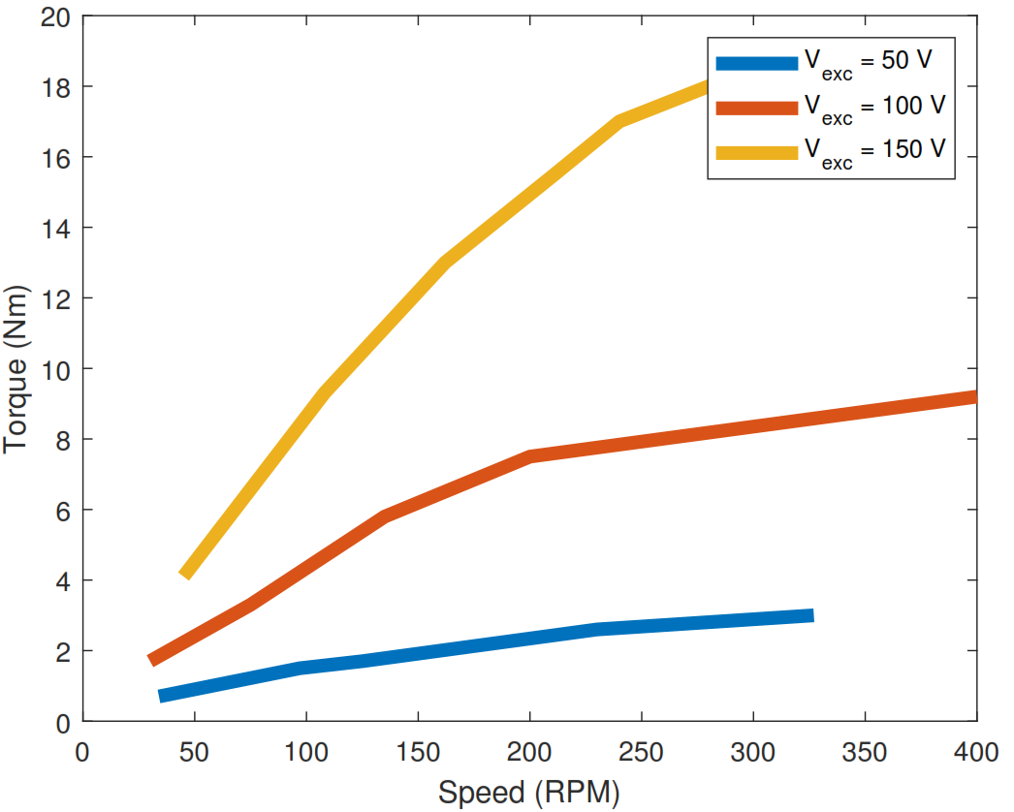
Load difference
Load motor
Go-kart load

Slide 3
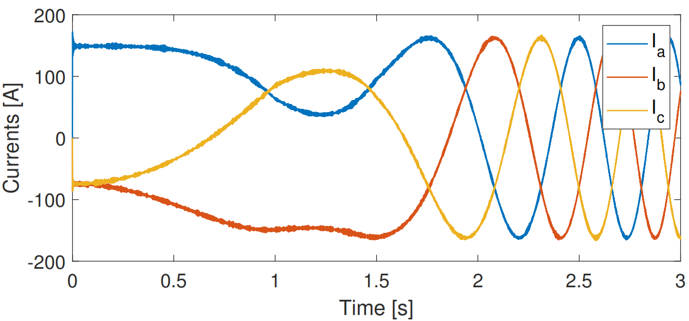
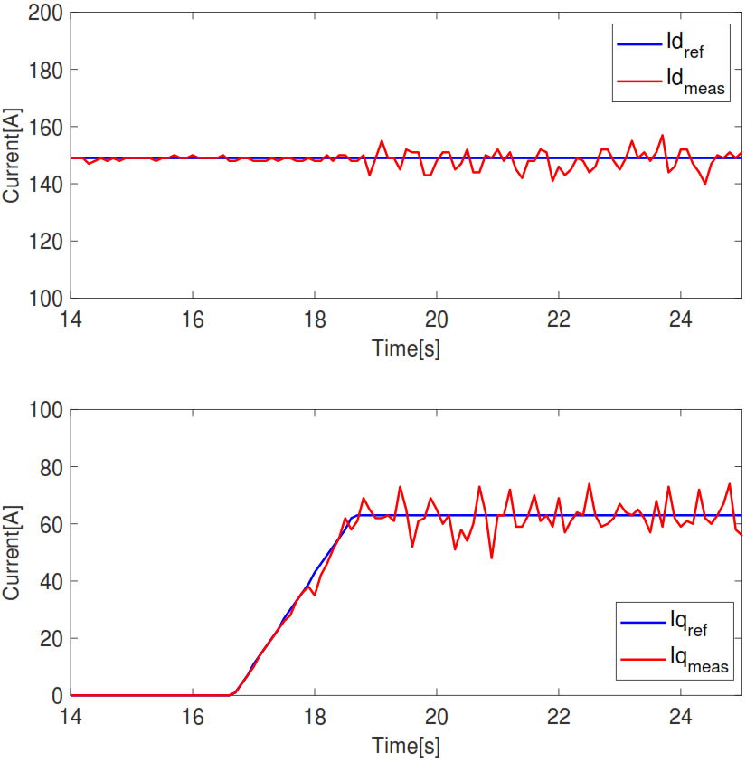
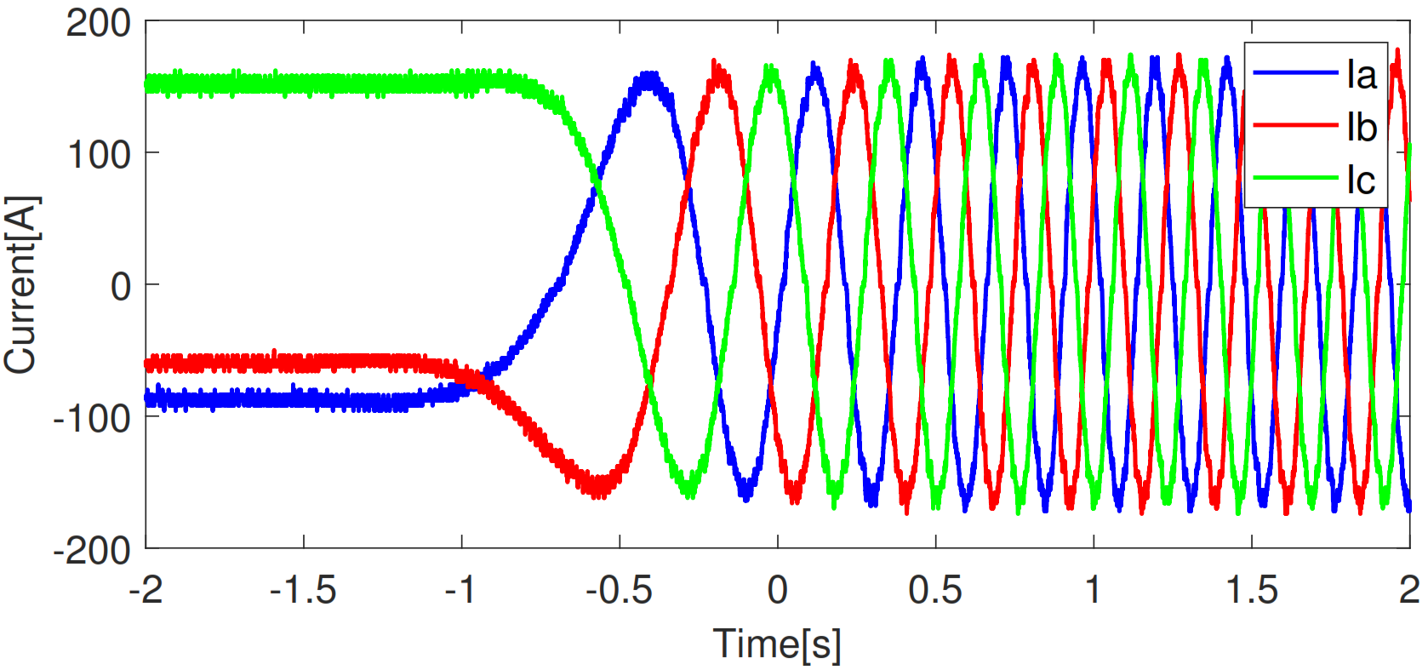
Torque control - Startup

Slide 4
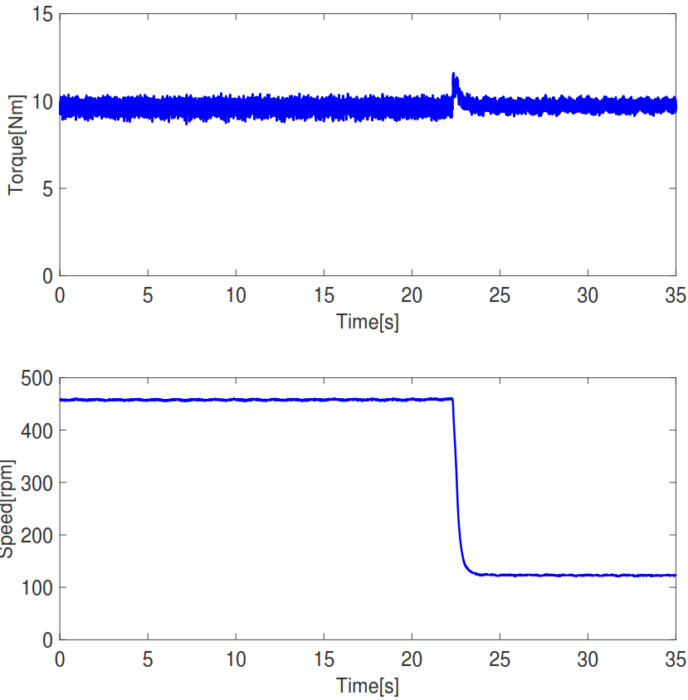
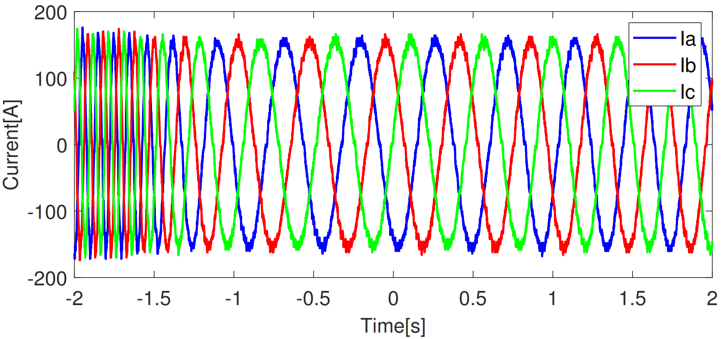
Torque control – Load change

Slide 5
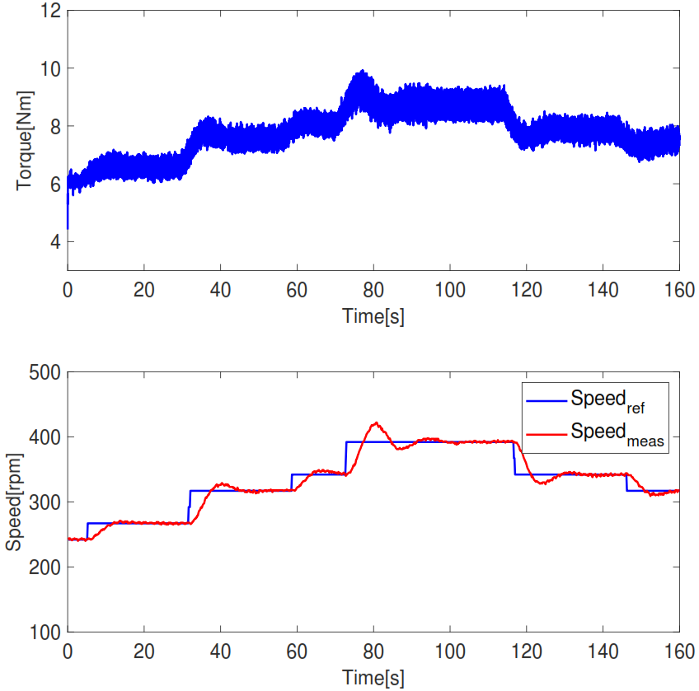
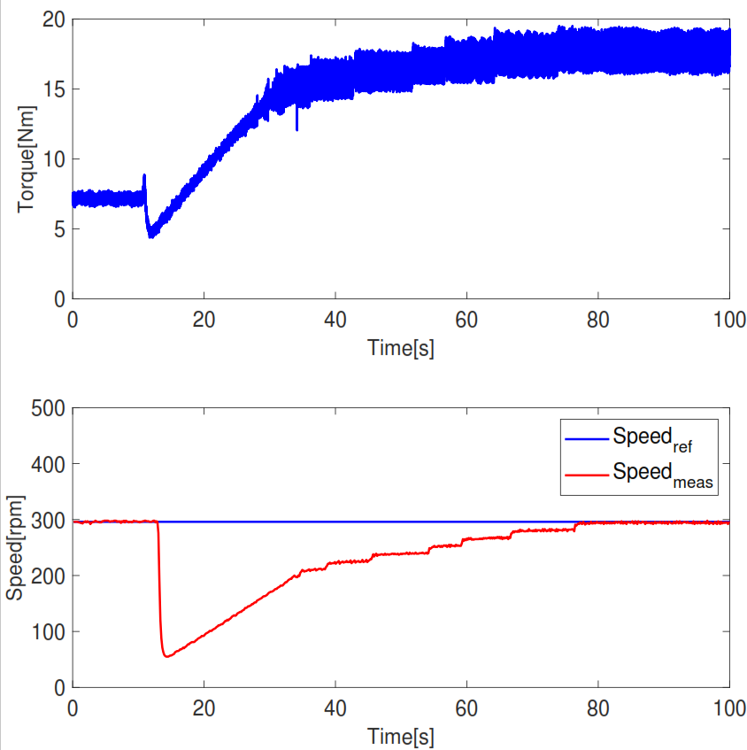
Speed control
Speed variation
Load variation

Slide 6
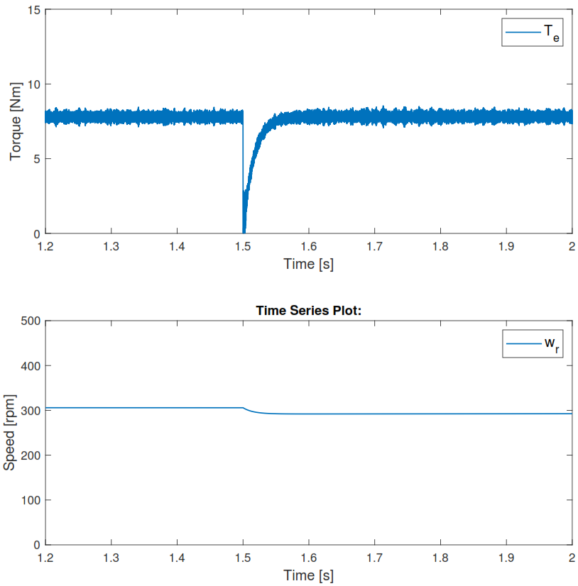
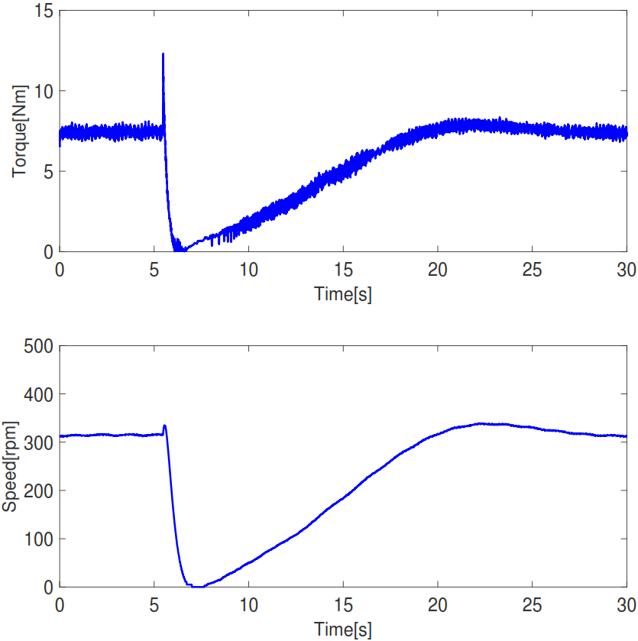
Torque to speed transition
Simulation
Tests

Slide 7
Future work
Slide
of 59
Alternative approach in field oriented control.
Implementation of regenerative braking.
Performance at higher switching frequency.
Integrating the power train in the go-kart platform.
Thassilo

Slide 8
Thank you for your attention
Questions?

